Slide 1
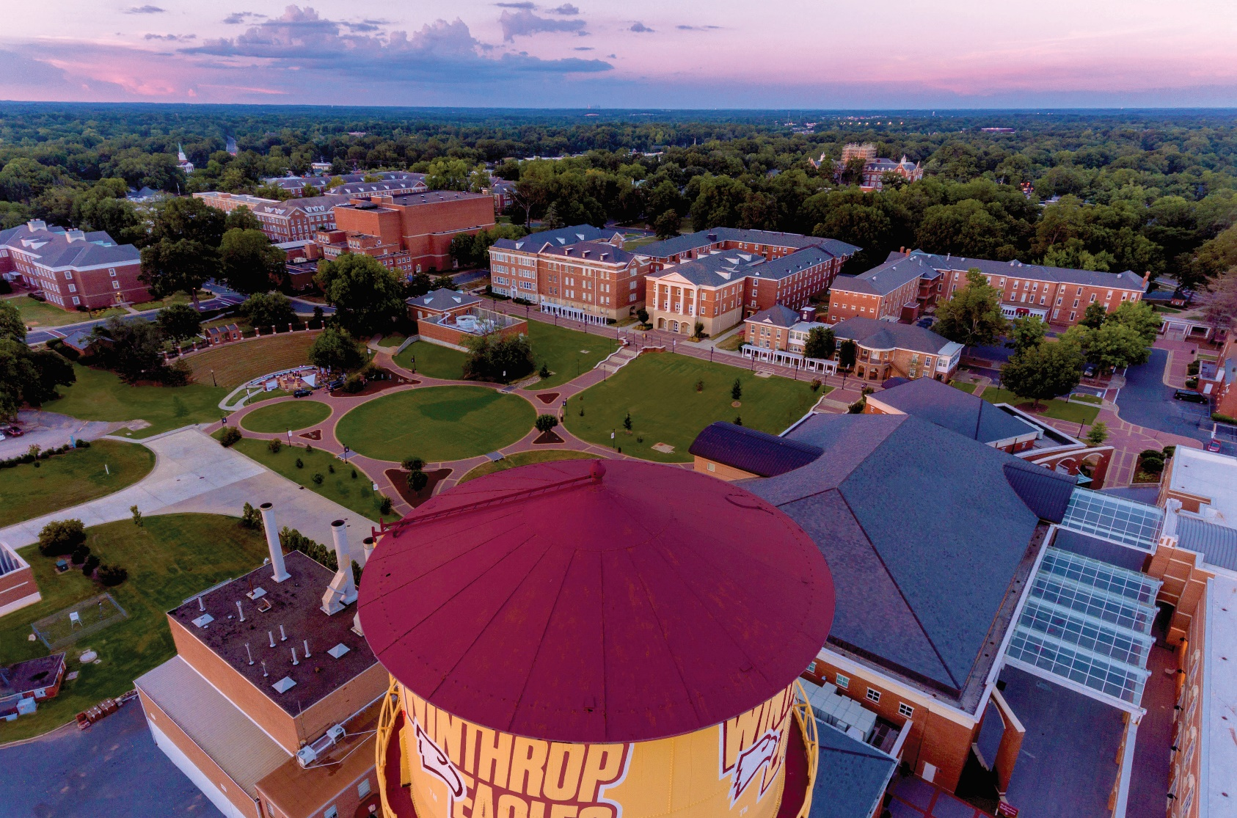
Winthrop University
Budget Request 2022-2023

Slide 2
Covid-19 Update
CARES Acts Student – Award $2,691,065; Spent $2,691,065. Student emergency grants to assist with COVID-related costs for living expenses, etc.
CARES Acts Institutional – Award $2,691,065; Spent $2,691,065. Offset COVID-19 room and board adjustment reimbursements to students.
CARES Acts SIP – Award $266,144; Spent $266,144. Offset COVID-19 room and board adjustment reimbursements to students.
CRRSAA Student – Award $2,691,065; Spent $2,691,065. Student emergency grants to assist with COVID-related costs for living expenses, etc.
CRRSAA Institutional – Award $5,732,109; Spent $5,732,109. Offset lost revenue for tuition, room, board, and safety.
CRRSAA SIP – Award $266,144; Spent $266,144. Offset lost revenue for tuition, room, board, and safety.
ARP Student – Award $7,386,899; Spent $7,318,717. Student emergency grants to assist with COVID-related costs for living expenses, etc.
ARP Institutional – Award $7,374,604; Spent $6,239. Planned to offset lost revenue and COVID-related expenses.
ARP SIP – Award $652,879; Spent $0. Planned to offset lost revenue and COVID-related expenses.
Notes:
Finance / Academic / HR

Slide 3
Covid-19 Update (con’t)
SC Cares– Award $3,022,067. Spent $1,570,178 on FY20 expenses and $1,451,889 on FY21 expenses. Spent on COVID-related payroll expenses (salaries, sick leave, and medical leave), telework capability improvements, distance learning (educational), food deliveries for quarantined students, medical supplies, disinfection, COVID-19 testing, and other general expenses related to COVID-19.
Notes:
Finance / Academic / HR

Slide 4
Appropriations History
Total:
$173,364,657
Total:
$180,370,670
Notes:
Finance

Slide 5
FY 22 Projected Current Revenue
Total: $151,399,130
Notes:
Finance

Slide 6
FY 22 Projected Current Expenses
Total: $149,570,773
Notes:
Finance

Slide 7
Recurring Request
Request | Amount | Description
Instructional Scientific Equipment | $1.7M | While Winthrop has allocated funds to replace instructional equipment, heavy use of the equipment continues to outpace our ability to replace items ​ Winthrop procured roughly half of recently identified equipment needs ($2M of $4M in needed equipment upgrades) through a Master Lease in 2019, the costs of which were absorbed into our E&G expenses ​ While we have been successful in obtaining some grants to supplement institutional funds, such grants do not provide the consistent support needed for ongoing maintenance and replacement​
Notes:
Old Presentation

Slide 8
Non-Recurring Request
Request | Amount | Description
Operational Support for STEAM Disciplines | $2.0M | In support of Winthrop’s commitment to promote access and degree attainment and to enhance the learning experience for our students, funding is requested to support students in the STEAM fields by continuing to provide up-to-date software, digital security, and new digital equipment/technology​ Support increasing need for digital resources, cloud-based licensing, and online program delivery and support resources to ensure students graduate with competitive skills in the market and on-time completion by both undergraduate and graduate students, including new professional adult learners Fund recurring software for GIS (Geographic Information Systems) technology and other systems
Notes:
Old Presentation

Slide 9
Non-Recurring Request
Request | Amount Requested | Description of Request
Maintaining Campus Infrastructure | $15.5 million | Building roofs, envelope, & architectural detail repairs and replacement ($2.9M) Mechanical, plumbing, electrical, & HVAC upgrades ($2.1M) Phase 2 to improve Wi-Fi coverage in classroom facilities ($2.0M) Steam, boiler, and chiller upgrades ($5M) Campus ADA modifications ($1.5M) Other campus upgrades in scientific buildings ($1.9M)
Arts & Technologies Facility Additions/ Renovations | $9.0 million | Upgrade existing infrastructure and build an interdisciplinary technology facility (approximately 21,500 s.f.) to support student experiential learning for career preparation in the expanding music, performance, and software industries (Include audio and video recording and editing studios, sound isolation booths, screening/mixing theater, and rehearsal spaces for small and large groups)
Notes:
Old Presentation

Slide 10
Non-Recurring Request, Continued
Request | Amount Requested | Description of Request
Winthrop University Science Complex Renovation | $9.0 million | Renovate three teaching labs, two classrooms, faculty offices, and research labs in Dalton Hall, a life science facility Renovate four teaching labs, three classrooms, two computer labs, faculty offices, and research labs in Sims Building, a chemistry, physics, and geology facility
Dacus Library Renovation | $7.0 million | Enhance library based on trends in the industry to create more study space and technology
Notes:
Old Presentation

Slide 11
General Provisos
Winthrop requests to keep:
117.7 Fee Increases
117.8 State Institutions – Revenues & Income
117.11 Fixed Student Fees
117.14 FTE Management
117.15 Allowance for Residences & Compensation Restrictions
117.16 Universities & Colleges – Allowance for Presidents
117.20 Travel – Subsistence Expenses & Mileage
117.29 Base Budget Analysis
117.44 Parking Fees
117.46 Insurance Claims
117.58 Purchase Card Incentive Rebates
117.70 Reduction in Force/Agency Head Furlough
117.71 Printed Report Requirements
117.82 Bank Account Transparency & Accountability
117.110 Information Technology & Information Security Plans
117.117 Statewide Strategic Information Technology Plan Implementation
Winthrop has submitted no proviso requests.
Notes:
Old Presentation + Finance for New

Slide 12
Appendix

Slide 13
Student Enrollment– Fall 2021
Total Enrollment 5,166* (a decrease from 5,576 in Fall 2020)
  Fall First-Time Full Time Undergraduate Cohort of 819
  Undergraduate Retention Rate of 67.9% (2020 cohort)
  Undergraduate 6-year Graduation Rate of 60.7% (2014 cohort)
  Student Placement Rate of 91%
​ | HeadCount​ | In-State %​
Undergraduate​ | 3,973​ | 89.5%​
Graduate​ | 1,193 | 68.8%​
Total​ | 5,166 | 84.7%​

Slide 14
Student Enrollment
Official data as reported to CHE.

Slide 15
Student Enrollment (con’t)
Admissions standards for first-time entering freshmen reported to CHE annually.

Slide 16
In-State and Out-of-State Headcount vs. FTE, Fall 2021
FTE is calculated using the Common Data Set methodology.
Notes:
AAAS

Slide 17
Graduation Data
80.8%
75.6%
Source: National Student Clearinghouse Report and Winthrop Graduation Rate Data as reported to IPEDS..
Notes:
Finance

Slide 18
Tuition and Fees Per Semester, Undergraduate
FY17 - FY18 Increase
2.48%
FY18 - FY19
Increase
2.4%
FY19 – FY20
Increase
0.5%
FY20 – FY21
Increase
0 %
FY21 – FY22
Increase
0%

Slide 19
2021-22 Tuition & Fee Schedule, Undergraduate
Full-time Undergraduate Fees per Semester * | Resident | Non-Resident
E & G Operating | 6,165 | 12,744
Information Technology | 155 | 155
Student Activity | 790 | 790
Debt Service Institutional Bonds (tuition) | 521 | 1,107
Debt Service Revenue Bonds (athletic) | 22 | 22
Total | $7,653 | $14,818
% Increase from Previous Year | 0.0% | 0.0%
*Based on 12 or more credit hours

Slide 20
2021-22 Tuition & Fee Schedule, Graduate
Full-time Graduate Fees per Semester * | Resident | Non-Resident
E & G Operating | 6,248 | 12,827
Information Technology | 155 | 155
Student Activity | 790 | 790
Debt Service Institutional Bonds (tuition) | 521 | 1,107
Debt Service Revenue Bonds (athletic) | 22 | 22
Total | $7,736 | $14,901
% Increase from Previous Year | 1.0% | 1.0%
*Based on 12 or more credit hours

Slide 21
Scholarships & Grants
 | 2020-21
 | Dollars
FEDERAL
PELL Grant | $9,195,721
SEOG Grant | $347,020
TEACH | $231,012
Total | $9,773,753
STATE
LIFE Scholarship | $9,320,117
Palmetto Fellows Scholarship | $1,758,234
HOPE Scholarship | $840,614
SC Need Based Grant | $1,878,512
SC Need Based Grant - CTP Students | $62.864
National Guard Grant | $31,500
Teaching Fellows (loan forgive w/ work in-state) | $743,151
SC Foster Care Youth Program | $4,000
Total | $14,638,992
INSTITUTIONAL SCHOLARSHIPS & GRANTS
Merit | $6,944,653
Athletic & Talent | $2,487,557
Named Restricted | $1,697,639
Public Service | $2,237,998
Total | $13,367,847
Notes:
UPDATE

Slide 22
Annual Debt Service FY21-FY30
Notes:
Finance

Slide 23
Annual Debt Service FY21-FY30
Notes:
Finance

Slide 24
Employees
Winthrop has 1,115 employees and a total annual payroll of $53.1M.
 | Authorized | Vacant
State | 442.96 | 55.8928
Federal | 6.8 | 0.15
Other | 365.02 | 45.0725
Total | 814.78 | 101.1153
Notes:
UPDATE

Slide 25
Employees, Continued
No administration reported in the American Indian/Alaskan, International/Non-Resident Alien, and Native Hawaiian/Pacific Islander categories
Official data as reported to IPEDS.
Notes:
AAAS / HR

Slide 26
4% Tuition Waivers & Abatements
HC = headcount R = resident NR = non-resident (Source: Institutional Data Files & Proviso 11.29 Report)

Slide 27
Capital Projects
Music Conservatory/Byrnes Auditorium
Project number is 9579
Funded by capital reserve funds (on-hold)
Current balance is $3,513,905
Byrnes Fire Restoration
Project number is 9580
Funded by other funds (institutional capital project funds)
Current balance is $48,820
General Building Infrastructure/Building Envelope Upgrade
Project number is 9581
Funded by capital reserve funds
Current balance is $2,680,245
Notes:
Finance

Slide 28
Capital Projects, Continued
High Voltage Electrical Substation/System Upgrade
Project number is 9582
Funded by EDA grant and capital reserve funds
Current balance is $1,722,642
Steam, Replacement of Underground Steam Project number is 9584
Funded by capital reserve funds
Current balance is $2,100,488
Fire Alarm Replacement/Upgrade
Project number is 9585
Funded by capital reserve funds
Current balance is $1,997,625
Notes:
Finance

Slide 29
Capital Projects, Continued
Joynes Hall Interior Renovations
Project number is 9586
Funded by donation through Foundation
Current balance is $1,035,389
Lee Wicker Hall Auxiliary Bldg. Infrastructure & Envelope Upgrade Project number is 9587
Funded by auxiliary net position/auxiliary debt
Current balance is $26,250
Phelps Hall Auxiliary Bldg. Infrastructure & Envelope Upgrade Project number is 9588
Funded by auxiliary net position/auxiliary debt
Current balance is $26,250
Notes:
Finance

Slide 30
Capital Projects, Continued
Lee Wicker Hall Auxiliary Bldg. Infrastructure & Envelope Upgrade
Project number is 9589
Funded by donation through Foundation
Current balance is $82,500
Architect Detail Repairs/Replacement Bancroft/McLaurin Project number is 9590
Funded by capital reserve funds
Current balance is $1,200,000
General Building Mechanical System Replacement/Upgrade
Project number is 9591
Funded by capital reserve funds
Current balance is $1,000,000
Notes:
Finance

Slide 31
Capital Projects, Continued
Oil Tank Removal Project Project number is 9592
Funded by capital reserve funds
Current balance is $1,200,000
General Building Mechanical System Replacement/Upgrade
Project number is 9593
Funded by capital reserve funds
Current balance is $61,500
Notes:
Finance

Slide 32
Capital Projects, Continued
Campus E&G/Auxiliary Building WIFI Upgrade
Project number is 9594
Funded by net positon funds (institutional capital project funds & housing auxiliary funds)
Current balance is $45,000
Demolition for Wofford Hall (Residence Hall) Project number is 9595
Funded by auxiliary housing net position
Current balance is $54,500
Notes:
Finance

Slide 33
Maintenance
Winthrop addresses maintenance needs by the following methods:
Facilities maintains a rolling project list that includes facility maintenance and repair needs.
Campus constituents fill out a project request form, which includes project details such as roof repairs and replacement, fire alarm replacements, painting, electrical and small facility changes to accommodate programs.
These projects are given budget estimates and prioritized by senior leadership to complete as time and funding permits.
In FY 2020-21, Winthrop spent $4,689,432 on
maintenance needs.
Winthrop has ongoing projects for an additional $21.4M funded from state appropriations, Federal awards, gifts, and insurance proceeds.
Notes:
Finance

